Slide 1
Natural Language Processing
Mandate 2: Lexical Processing

Slide 2



The Need for Understanding Text
Social media analytics
Banking and loan processing
Insurance claims processing
Customer Relationship Management
Security and counter-terrorism
Computational Social Science
E-commerce
Psychology and Cognitive Science
Disclaimer: All logos and trademarks are owned by the respective copyright owners

Slide 3
The Problem of Understanding Text

Slide 4
Text, Language and Meaning
Meaning
Machine
Translation
Question
Answering
Conversational
UI
Language
Text
(User Generated Content)

Slide 5
Text, Language and Meaning
Meaning
Machine
Translation
Semantic Processing
General knowledge Domain Knowledge
Discourse Context
Question
Answering
Syntactic Processing
Conversational
UI
Language
Tokenization and Shallow Parsing
Lexical Processing
Text
(User Generated Content)

Slide 6
Text, Language and Meaning
Deep Learning Architectures
Meaning
Machine
Translation
Semantic Processing
General knowledge Domain Knowledge
Discourse Context
Question
Answering
Syntactic Processing
Conversational
UI
Language
Tokenization and Shallow Parsing
Lexical Processing
Text
(User Generated Content)

Slide 7
Lexical Processing

Slide 8
Characters and Encoding

Slide 9
Lexical Processing
Interpreting an input stream of data (usually text) in linguistic constructs like words, phrases, sentences, etc.
Involves:
Understanding of character encoding, word and sentence boundaries.
Use of distributional semantics to tokenize terms.
Shallow Parsing and POS tagging.
Entity Identification and Record linkage.
There is no hurry anymore. Everything is planned.
もう急いではありません。 すべてが計画されています。
Application for Residence Permit.
Aufenthaltsgehnemigungsantrag.
One (person) in a ten million.
ಕೋಟಿಗೊಬ್ಬ.
Greetings on your Birthday.
जन्मदिनप्रीत्यर्थं अभिनन्दनम।

Slide 10
Character Encoding
Character: The smallest unit of linguistic element
Character Set (Alphabet): Collection of characters that are used in one or more languages.
Example: Latin character set is used in English and many European Languages.
Devanagari character set is used in Hindi and many Indian languages
Character Encoding: A unique code assigned to a character based on the encoding standard, to represent it on the computer.
Code point: A code assigned to any character. A code point may either refer to a character, or have other meanings like formatting meta-data.

Slide 11

Unicode
A Universal character set used for encoding all character sets from most human languages
Contains 133,755 characters (as of 2017), representing 130 scripts
Common Unicode standards:
UTF-8: uses 1 byte for first 128 code points (backward compatible with ASCII) and up to 4 bytes for other characters
Logo of the Unicode consortium http://www.unicode.org/
Image source: Wikipedia
UTF-16: Uses 16 bits (2 bytes) to encode the Basic Multilingual Plane (BMP) that covers most languages, and up to 4 bytes for encoding other planes that covers historic scripts, hieroglyphs, etc.

Slide 12
Unicode Resources
Online tool for language encoding queries http://www.eki.ee/letter/
Devanagari Editor http://www.bookofindia.com/Hindi-Marathi-Editor.html
Google Translation Tools https://translate.google.com/
Unicode Character Picker https://r12a.github.io/pickers/
Unicode and Python
Using Unicode in Python https://wiki.python.org/moin/Unicode
Unicode in Python, Completely demystified http://farmdev.com/talks/unicode/

Slide 13
Term Extraction and Processing

Slide 14
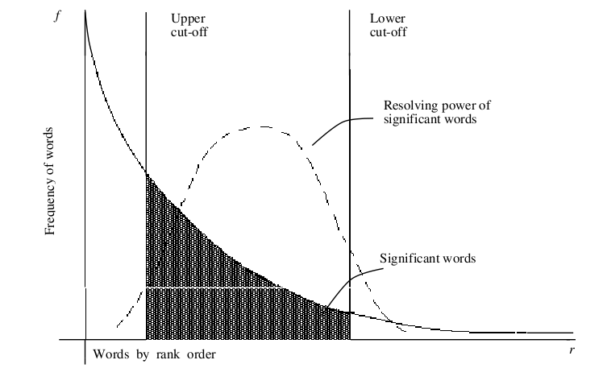
Word frequency and significance
Word distribution in documents found to be very skewed -- approximated by a Zipf distribution
Product of frequency and rank order of words approximately constant:
Most highly occurring terms are “language builders” (terms like is, an, the, for, etc. in English)
Such terms having no relevance to document content are called “stop words” and are typically removed from consideration
Image source: [Rijsbergen '79]

Slide 15
Word frequency and significance
Word significance is shown to form a Gaussian distribution over a rank ordering of terms based on frequency
Too frequently occurring words, as well as too rarely occurring terms are less significant to the document
Word significance computed by a lower and upper cutoff (typically first and fourth quartile) over the rank ordering
Significance of sentences in the document computed based on significance scores of words forming the sentence.
Image source: [Rijsbergen '79]

Slide 16
Stopwords
Most relevant terms for a document lie somewhere in the middle of the term distribution chart
Most highly occurring terms are “language builders” (terms like is, an, the, for, etc. in English)
Such terms having no relevance to document content are called “stop words” and are typically removed from consideration.
Publicly available stopword lists:
English
http://armandbrahaj.blog.al/2009/04/14/list-of-english-stop-words/ http://www.textfixer.com/resources/common-english-words.txt
Hindi
http://mail.sarai.net/pipermail/prc/Week-of-Mon-20080204/001656.html
German
http://www.solariz.de/blog/70-deutsche-stopwords http://www.ranks.nl/stopwords/german.html

Slide 17
Term Extraction
Regular Expressions
Most commonly used technique for string pattern matching
Supported by many present-day scripting languages
Regular expressions in python available from the re package.
Python RE tutorial: https://www.w3schools.com/python/python_regex.asp
Definition of an RE:
Any atomic symbol is an RE
If u and v are REs then so are:
(u), u*, u+, u+v, uv

Slide 18
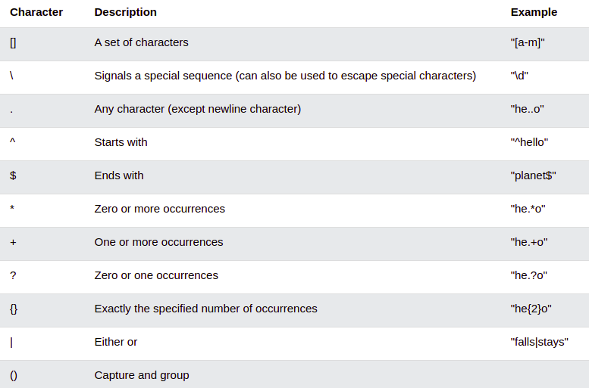
Term Extraction
Python regex metacharacters

Slide 19
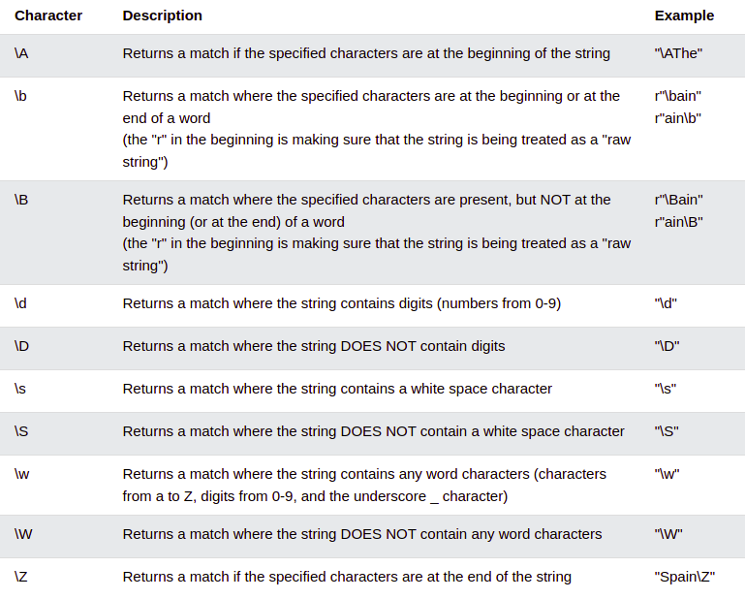
Term Extraction
Python regex metacharacters

Slide 20
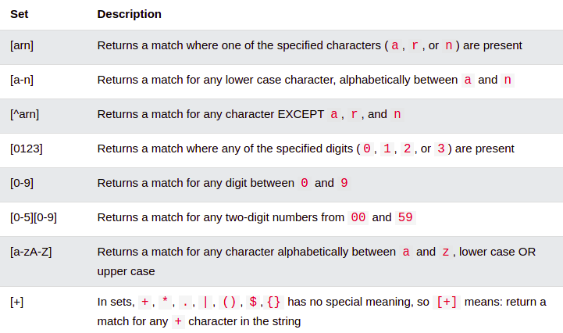
Term Extraction
Python regex metacharacters

Slide 21
Term Extraction
Regular Expressions
Interpret the following regular expressions:
[A-Za-z\.0-9\_\-]+@([A-Za-z0-9\-\_]*\.?)+
[Uu]nivers.{3,4}
http(s)?:\/\/[\w\.]*\w(\/)?
Write regular expressions for the following:
Match any roll number of the iMTech 2018 batch
Match commas in a line of string except when the comma appears in a quoted string. For example: a,”b,c” should match the first comma and not the second.
Match and remove HTML tags from a page showing HTML source

Slide 22
Stemming
Stemming or Conflation helps revert a word to its canonical “base” term across morphological equivalents
For example: “gained”, “gaining”, “gainful”, etc. are all morphological equivalents of the term “gain”
Common stemming techniques look for commonly occurring suffixes and truncate them from the word.
Dictionary lookups or lexicons (eg. WordNet http://wordnet.princeton.edu/) are also used.
Stemming algorithms and packages:
Porter Stemmer https://tartarus.org/martin/PorterStemmer/
Snowball Stemmers for different languages https://xapian.org/docs/stemming.html

Slide 23
Lemmatization
Lemmatization is the process of arriving at the root (lemma) of a word by the use of a dictionary, rather than through lexical manipulations
For example: the lemma of driving, drove and driven is drive, the lemma of see, saw and seen is see.

Slide 24
Canonicalization
Refers to the process of reducing different variants of a given term to its common “base” form
Variants may be due to:
Phonetic or spelling variations (Agrawal, Agarwal, Aggarwal)
Misspellings
Abbreviations or alternate representations

Slide 25
Canonicalization
Phonetic Hashing
Often term similarities need to be computed on a phonetic basis (ex: in spelling mistake corrections)
Phonetic hashing is a technique based on converting a term into a set of phonemes and comparing similarity
Phoneme: smallest segmental unit of sound that creates contrasts in utterances
Similar sounding words mapped to same bucket
Family of algorithms called “Soundex” developed for phonetic rules in various languages
Soundex code in Ruby: http://snippets.dzone.com/posts/show/4530
Soundex in Javascript: http://snippets.dzone.com/posts/show/844
Perl Module for Soundex: http://search.cpan.org/~markm/Text-Soundex-3.03/Soundex.pm

Slide 26
Canonicalization
Soundex
Originally an algorithm for phonetic hashing, now refers to any algorithm for phonetic hashing
Terms given a hash code based on English pronunciation
Based on a rationale that English pronunciation depends on the first letter and pattern of consonants (Ex: flwr, arpln, brdg, etc.)
Algorithm for American Soundex:
First letter of name retained as is
Replace consonants with digits according to the following: b, f, p, v ⇒ 1 c, g, j, k, q, s, x, z ⇒ 2 d, t ⇒ 3 l ⇒ 4 m, n ⇒ 5 r ⇒ 6 h, w, y ⇒ unencoded
Two adjacent letters with the same number are coded as a single number. Letters with the same number separated by a vowel or an h or w are also coded as a single number
Continue till the code has 1 letter and 3 numbers. If too few numbers, pad with 0s.

Slide 27
Canonicalization
Soundex Examples
Bangalore => B524
Bengaluru => B524
Bagalkote => B242
Bombay => B510
Bambai => B510
Mumbai => M510
Online Soundex Converter http://resources.rootsweb.ancestry.com/cgi-bin/soundexconverter

Slide 28
Canonicalization
Edit Distance
A commonly used distance metric to collapse nearby words
The edit distance (also called Levenstein distance) between two strings p and q is the minimum number of character edit operations (add, delete, modify) required to convert one into the other
Edit distance examples:
● cat, dog : 3
● color, colour : 1
● apples, oranges : 5

Slide 29
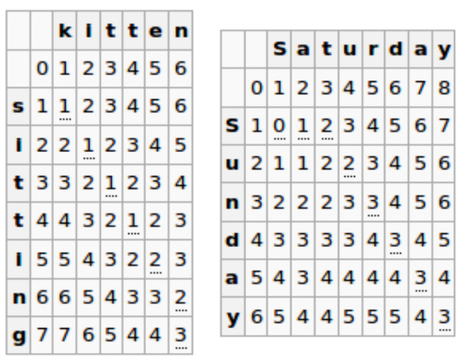
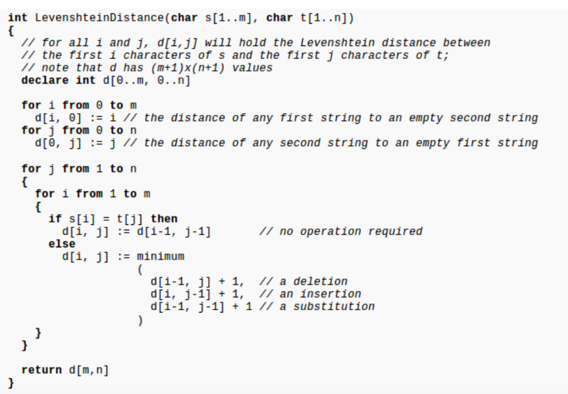
Canonicalization
Image source: Wikipedia

Slide 30
Canonicalization
k-gram vectors
Another form of representing terms that are robust against spelling variations and misspellings
A k-gram is a set of k consecutive characters obtained from a sliding window over an index term
Example
For the term:
tendulkar
the following are 3-grams:
$te, ten, end, ndu, dul, ulk, lka, kar, ar$
Note the augmented $ both at the beginning and end of the term

Slide 31

Canonicalization
k-gram vectors
A k-gram vector is a representation of a term in the form of its k-grams and their frequency
2-gram vectors for color and colour
Proximity of terms may be computed by dice index score of their k-gram vectors
$color$ | $colour$ | Inner product | Similarity
$c ⇒ 1 co ⇒ 1 ol ⇒ 1 lo ⇒ 1 or ⇒ 1 r$ ⇒ 1 | $c ⇒ 1 co ⇒ 1 ol ⇒ 1 lo ⇒ 1 ou ⇒ 1 ur ⇒ 1 r$ ⇒ 1 | $c ⇒ 1 co ⇒ 1 ol ⇒ 1 lo ⇒ 1 ou ⇒ 0 or ⇒ 0 ur ⇒ 0 r$ ⇒ 1 | 10/(5+6) = 0.909

Slide 32
Tokenization
Refers to formation of logical elements or “tokens” (or “terms”) from words
Tokenization rules specific to language
English related tokenization issues:
Phrase identification
Misspellings and spelling variants detection
Canonicalization
Not all words by themselves represent logical entities. Examples:
“New York” represents a single term, containing two words
Color and Colour represent two spellings of the same term
“Address” and “Addresses” are two utilitarian forms (plural) of the same term
“Ghandi” is a frequently used misspelling for the term “Gandhi”
Aufenthaltsgenehmigungsantrag contains three terms: Aufenthalt, Genehmigung, Antrag

Slide 33
Tokenization
Phrase Identification
A significant number of terms that appear are phrases are proper nouns
Example: New York, International Institute of Information Technology, Barnes and Noble, etc.
In English, proper nouns are usually written in capitalized forms that can aid in detecting phrases.
CAP detection (A1.1):
cap ← [], w ← nextWord(s)
if isCapitalizedWord(w)
cap << w
w ← nextWord(s)
while isCapitalized(w)
cap << w
return cap

Slide 34
Tokenization
Phrase Identification
Algorithm A1.1, while straightforward, is not without shortcomings.
“Barnes and Noble” in sentence 1 is a valid term, while “Mumbai and Delhi” in sentence 2 is not.
Barnes and Noble saw its share values reach new highs on a buying spree from investors
Mumbai and Delhi broke the record for annual number of airline passengers last year

Slide 35
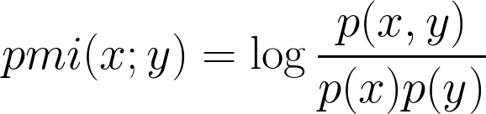
Tokenization
Pointwise Mutual Information (PMI)
A useful metric to calculate the likelihood of a given pair of words forming a valid phrase:
where p(x,y) is the probability of the phrase occurring in the corpus, and p(x) and p(y) are the marginal probabilities (or support) for words x and y in the corpus.
Pairs of words that do not form a phrase are likely to have high marginal probabilities, and their joint probability of occurrence would be close to the product of their marginal probabilities.

Slide 36


Tokenization
Pointwise Mutual Information (PMI)
Joint probabilities over multiple events can be extended from the pairwise joint probabilities using the chain rule:
Hence, for three word phrases, the PMI computation would be:
Example:

Slide 37
Occurrence Contexts
Marginal and joint probabilities computed based on underlying units called “occurrence contexts”
Typical examples of occurrence contexts in different corpora: sentence, paragraph, tweets, comments, etc.
We are now entering an era of politics of performance. Only politics that performs will get victory. Political party workers in various parts of the country are celebrating.
p(politics) = 3/3 = 1
p(perform) = ⅔
p(party) = ⅓
p(“politics of performance”) = ⅔
All terms measured after stemming...

Slide 38
Tokenization
N-gram Models
N-grams: A sequence of n consecutive elements (in our case, words) from an input stream
“to be or not to be…”
bigrams and their frequency, of the above sentence:
to be (2)
be or (1)
or not (1)
not to (1)
N-gram index
5
to
be
or
not
def bigram(s):
words = s.split(" ")
bigrams = [(words[i], words[i+1]) for i in range(0,len(words)-1)]
return bigrams
be
or
not
to
2
1
1
1

Slide 39

Tokenization
N-gram Models
N-gram models can approximate on the chain rule for phrase identification by an n-1 Markov property
Chain rule:
Bigram approximation:

Slide 40
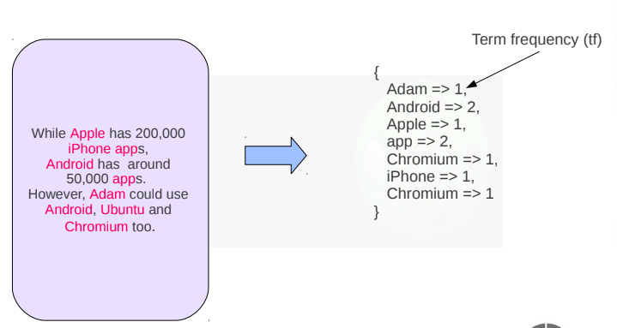
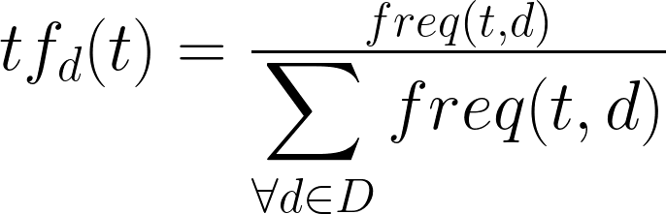
Scoring Models
Relevance scoring functions assign numerical weights indicating the relevance or more generally the “importance” of a keyword in a given context.
Bag of words document model
tf (term frequency) as a measure of importance

Slide 41
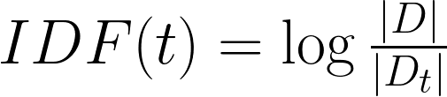
Scoring Models
IDF
As shown by the Zipf relevance model, term frequency alone cannot represent importance, as language builder terms tend to have very high frequency.
Even with stopword removal, there is a need for scoring the “uniqueness” of a term to a given context.
Inverse Document (context) Frequency (IDF/ICF) is a measure of uniqueness of term to a given document (context)
where D is the set of all documents (contexts) in the corpus, while D_{t} is the set of all documents (contexts) where t appears.

Slide 42
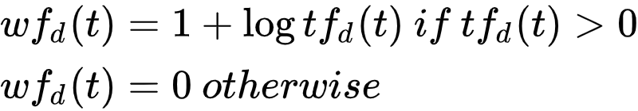
Scoring Models
tf-idf
Commonly used scoring model for text indexing and search
log-linear tf
Term importance is known to increase logarithmically w.r.t. frequency. This is used to derive the log linear tf function:

Slide 43
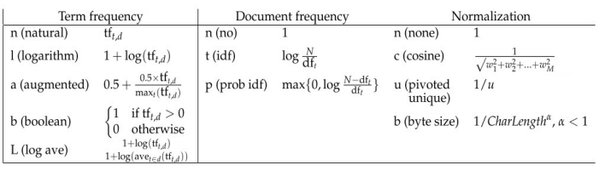
Scoring Models
Other variants over tf-idf

Slide 44
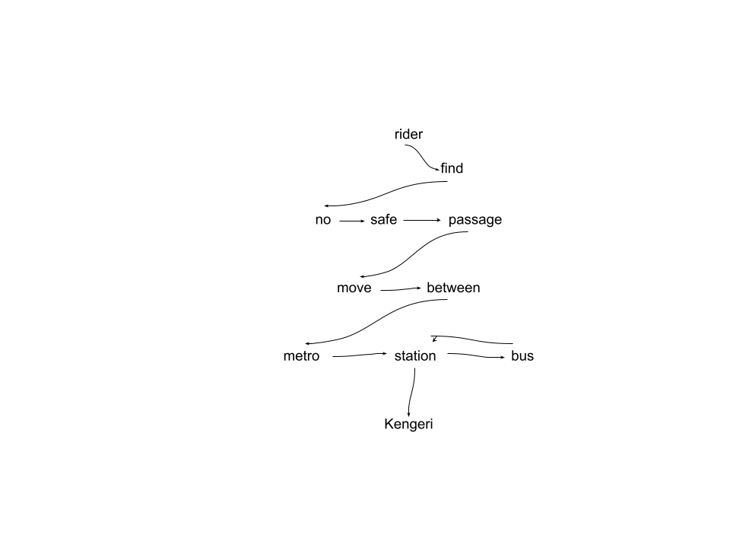

Scoring Models
TextRank
Text as a graph:
Riders find no safe passage to move between
metro station and bus station in Kengeri.
Computing importance of a given term:

Slide 45
Term Semantics

Slide 46
Semantic Disambiguation
Phonetic hashing and k-gram vectors are useful for lexical canonicalization, addressing issues like spelling variants, misspellings, etc.
Semantic disambiguation (also called semantic de-duplication) pertains to finding different terms used to refer to the same semantic entity.
Two broad approaches for addressing semantic disambiguation
Lexicons (ConceptNet, WordNet, etc.)
Distributional Semantics
Examples
Acronyms
FedEx, Federal Express
Aliases
Chennai, Madras
Ganga, Ganges

Slide 47
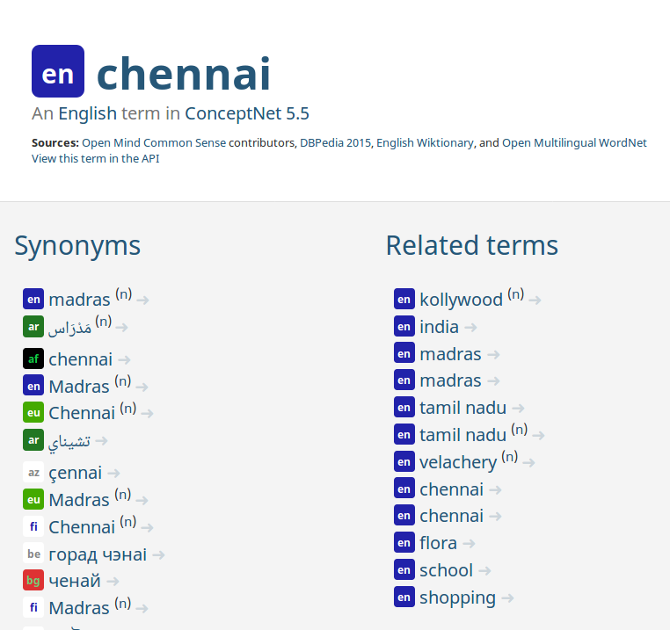
Semantic Disambiguation
Disambiguation using ConceptNet
ConceptNet.io http://conceptnet.io/ -- a freely available “common sense” semantic network characterizing meanings of words and relationships between them
Originated from the MIT OpenMind Commonsense, crowdsourcing project
Provides several semantic properties like: Synonyms, Related terms, Part-of, Type-of, etc.

Slide 48
Distributional Semantics
Characterizing the semantics of terms based on its usage.
Basis for Ordinary Language Philosophy (OLP)
“A word is characterized by the company it keeps”
“Words with similar meanings tend to be used in similar contexts.”
Guess the meaning of the term greebel in the below paragraph:
“Everyday, I go to work in a greebel. There are two options for me. The 8:15 slow greebel takes 45 minutes, while the 8:30 fast greebel takes me to work in 30 minutes. If I miss both, I can take the purple line greebel at 8:40, but will need to change twice before reaching office, an hour later.”

Slide 49
Distributional Semantics
Characterizing the neighbourhood of words
Distribution over Occurrence Contexts
Represented as a rectangular term x context (document) matrix
Rows represent term vectors while columns represent context vectors
Example: LSA
Distribution over Co-occurrence of terms
Represented as a square matrix showing co-occurrence between terms in different occurrence contexts
Also called Syntagmatic Distributional Semantics
Example: HAL, Word2vec, GloVe

Slide 50
Distributional Semantics
Term-context Occurrence Matrix
C₁ C₂ C₃ C₄ C₅ …. …. C_{n}
t₁
t₂
t₃
t₄
t₅
...
f_{1,1} f_{1,2} f_{1,3} f_{1,4} f_{1,5} …. …. f_{1,n}
f_{2,1} f_{2,2} f_{2,3} f_{2,4} f_{2,5} …. …. f_{2,n}
….
….
….
Term distributional vector
Context / document distributional vector

Slide 51




Distributional Semantics
Distributional incidence Matrix
Distributional frequency Matrix
Distributional Relevancy Matrix (tf-idf)
where
|C| is the number of occurrence contexts and |C_{ti}| is the number of contexts where t_{i} has occurred.
Idf can be seen as the self information (uniqueness, surprisal) of a term appearing in any context

Slide 52
Distributional Semantics
Co-occurrence Matrix
A square matrix C_{m,m} where m is the number of terms in the corpus, depicting the co-occurrence of terms
Basic model of capturing co-occurrence frequency results in a symmetric matrix
Variants like conditional probability of co-occurrence, results in non-symmetric matrix
Capturing co-occurrence
Occurrence context
Divide the corpus into occurrence contexts. A pair of terms said to co-occur if they occur in the same context
Skip-grams
A k-skip-N-gram is a sequence of N (not necessarily consecutive) words where the distance between any two words is at most k.
Generate all skip-grams from the corpus using a sliding window over the text stream. A pair of terms are said to co-occur if they appear in the same skip-gram.

Slide 53
Distributional Semantics
 | fly | sitting | wall | cat | fence
fly | 1 | 1 | 1 | 0 | 0
sitting | 1 | 1 | 1 | 1 | 1
wall | 1 | 1 | 1 | 0 | 0
cat | 0 | 1 | 0 | 1 | 1
fence | 0 | 1 | 0 | 1 | 1
Input text
There is a fly sitting on the wall. The cat is sitting on the fence.
3-skip-2-grams
fly sitting, sitting wall, wall cat, cat sitting, sitting fence
Context co-occurrence
 | fly | sitting | wall | cat | fence
fly | 1 | 1 | 0 | 0 | 0
sitting | 1 | 1 | 1 | 1 | 1
wall | 0 | 1 | 1 | 1 | 0
cat | 0 | 1 | 0 | 1 | 0
fence | 0 | 1 | 0 | 0 | 1
skip-gram co-occurrence

Slide 54
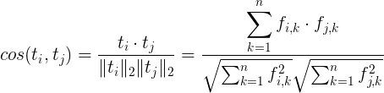

Distributional Semantics
Comparing Word Vectors
L_{p} Norm
Given t_{i} = (f_{i,1}, f_{i,2}, …, f_{i,n}) and t_{j} = (f_{j,1}, f_{j,2}, …, f_{j,n})
p=1: Manhattan distance
p=2: Eucledian distance
Cosine similarity
Since distributional values are all non-negative cosine similarity values, range between 0 and 1.

Slide 55
Distributional Semantics
Word Embeddings
Raw matrix (either term-document or term co-occurrence) too noisy due to following factors:
Spurious terms increasing dimensionality
Correlations between dimensions
Sparse matrices
Word embedding is a process of mapping words (terms) to a (typically smaller dimension) vector space that preserves their distributional semantics
HD raw vectors
(millions of dimensions)
LD word embeddings
(hundreds of dimensions)
SVD /
PCA /
CBOW /
Skipgrams

Slide 56
Distributional Semantics
Word Embeddings
Two broad types of approaches to compute word vectors:
Frequency based approaches
Prediction based approaches
Frequency based embedding models
Dimensionality reduction over term-context incidence matrix using matrix factorization techniques like eigendecomposition and SVD
Prediction based embedding models
Maximizes probability of generation of terms given occurrence contexts. Examples: Skip-grams, CBOW

Slide 57
Distributional Semantics
Word Embeddings using SVD (Ex: LSA)
Given a term-context matrix A of size m x n depicting occurrence frequencies of terms across different contexts, factorize the matrix as follows:
Where r is the rank of matrix A.
The matrix U represents the r dominant eigenvectors of A A^{T}
The matrix V represents the r dominant eigenvectors of A^{T}A
∑ is a diagonal matrix represent the r non-zero singular values of A, computed as the square roots of the non-zero eigenvalues of A^{T}A and AA^{T}.

Slide 58
Distributional Semantics
Word Embeddings using SVD (Ex: LSA)
Latent Semantic Analysis (LSA) uses SVD to decompose a term-context matrix to a rank-k approximation
That is, only retain the top k singular values and the corresponding eigenvectors from U and V^{T} to compute the lower dimensional factorization:
Rows of U now represent term embeddings in k-dimensional space
Rows of V^{T} now represent context (document) embeddings in k-dimensional space

Slide 59
Distributional Semantics
Word Embeddings using Skipgrams
(Ex: word2vec)
Prediction based embedding models based on maximizing the probability of generation of a term given a surrounding context or vice versa.
Ex: “what will be will be”
Skipgrams training sets:
([will], what), ([what, be], will), ([will,will], be), ([will], be)
Skipgrams
Input matrix
V x N
Output matrix
V x N
what
will
N
be
V
V

Slide 60

Distributional Semantics
Word Embeddings using Skipgrams
Skipgram based embeddings are based on predicting the co-occurrence context, given a word
Embeddings computed by training a shallow neural network with a single hidden layer of N neurons (dimensionality of the word vector), with one input layer of size V providing inputs as 1-hot vectors, and training outputs as c 1-hot vectors, where c is the window size.
The input word is typically in the middle of the context with c/2 words in either direction.
Objective function: maximize the average log probability of the context, given a word
Where w^{c}_{i} is the context around word w_{i}, and w^{c} is the set of all contexts for all words in the vocabulary

Slide 61
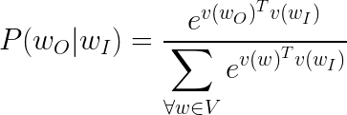
Distributional Semantics
Word Embeddings using Skipgrams
Example sentence:
I think, therefore I am
Training samples (with c=2):
(I, think) (think, I) (think, therefore)
(therefore, think) (therefore, I)
(I, therefore), (I, am)
P(w^{c}_{i}|w_{i}) is modeled as a softmax function over the input and output word vectors v(w_{O}) and v(w_{I}) averaged over all words in the vocabulary:

Slide 62
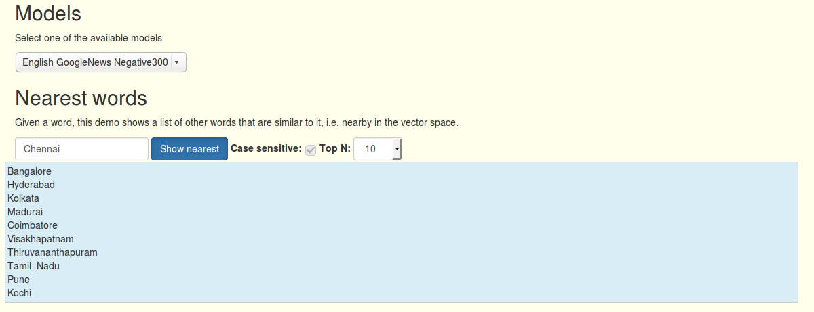
Word2vec demo
Demo source: http://bionlp-www.utu.fi/wv_demo/

Slide 63
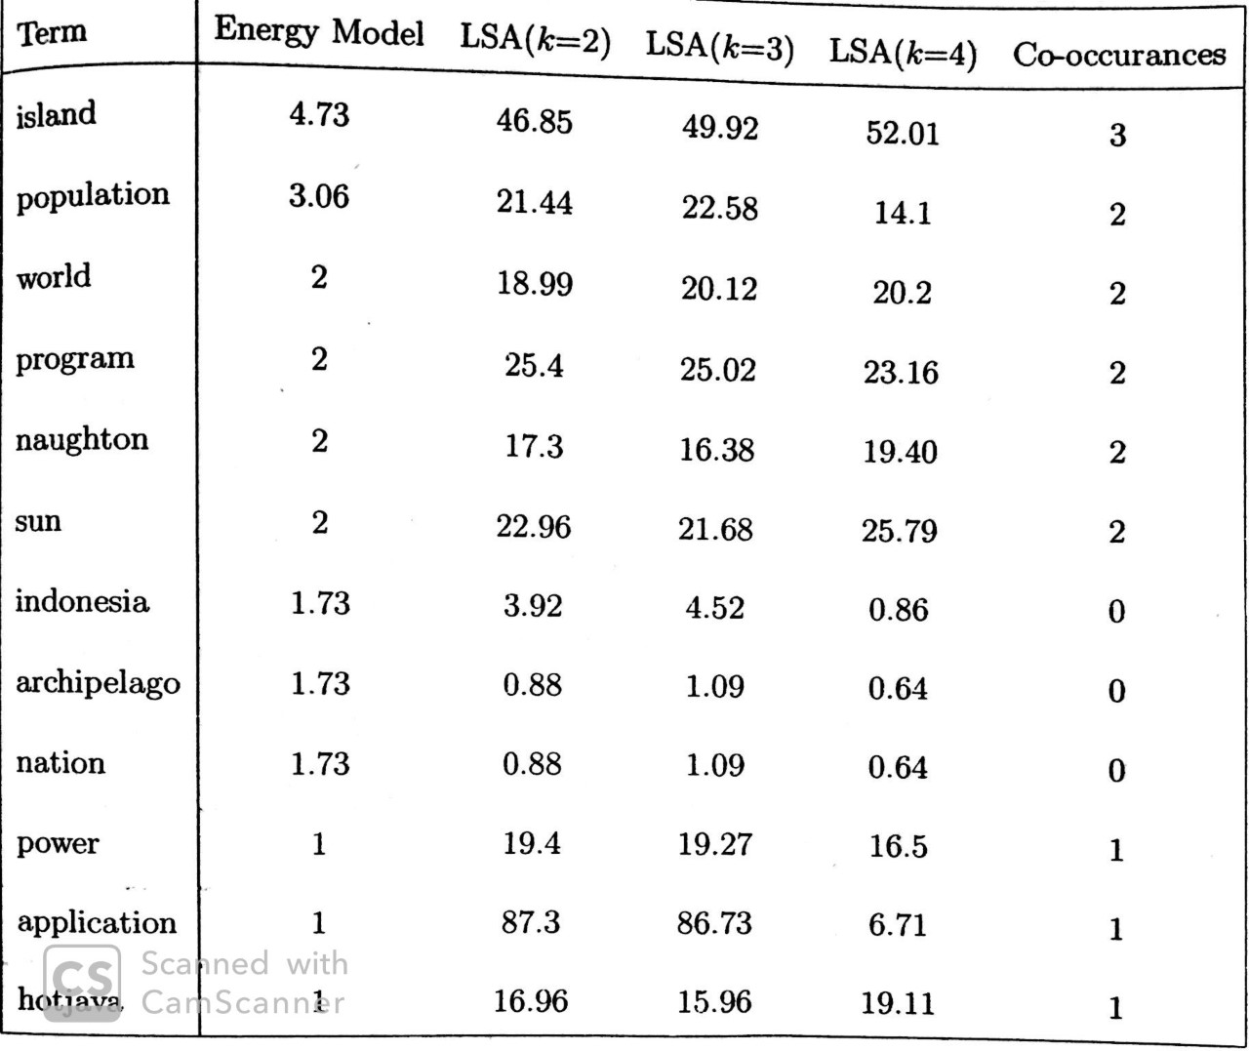
The Polysemy Problem
Polysemy: Multiple meanings of a word within a given sense.
Hypernymy: Multiple meanings of a word across senses.
Vectorization (embedding) solutions based on linear or non-linear maps, end up creating spurious associations due to polysemy / hypernymy.
Rachakonda, Aditya Ramana, and Srinath Srinivasa. "Incremental aggregation of latent semantics using a graph-based energy model." In International Symposium on String Processing and Information Retrieval, pp. 354-359. Springer, Berlin, Heidelberg, 2006.

Slide 64
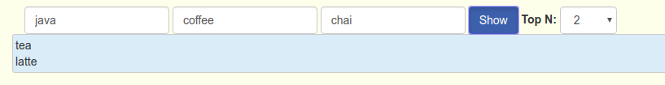


The Polysemy Problem
Polysemy in word analogy computation using word embeddings: Dominant sense prevails when a highly polysemic term is provided in the second part of an analogy problem.
From: http://bionlp-www.utu.fi/wv_demo/

Slide 65
Long Range Dependency
Several complex problems like polysemy resolution, co-reference resolution, etc. appear due to long range dependency (LRDs) in sentence structures
Skipgram or CBOW based sliding window techniques often insufficient to resolve LRDs
Masked language models based on self-attention have appeared in recent times to address LRDs and associated challenges
Java is an awesome programming language
Java is an awesome vacation retreat
The two uses of the term Java appear in the same context for a Skipgram context size of 3.

Slide 66
Masked Language Model
Masked Language Model (MLM) is an generalization over Skipgrams, where inputs are provided as sentences with some elements missing (masked)
A neural network is then trained to predict the missing term
Typical architectures for MLM include deep neural networks with attention (transformers) which could be uni-directional or bi-directional
Uni-directional model: Process the text in only one direction (typically left to right). Useful for predicting the next word given a sequence of words.
Bi-directional model: Process input sentence from both directions to predict the masked word. More versatile and applicable to several fine-tuned application contexts.

Slide 67
Masked Language Model
Unidirectional language models perform poorly on polysemic terms
For instance, consider the sentences:
“I stood by the bank for 2 hours to get to the ATM”
“I stood by the bank for 2 hours watching the river flow”
A left-to-right Seq2seq model like LSTM encodes the term “bank” with the same context “I stood by the” for both sentences.
A bidirectional model would encode the term “bank” differently for both sentences because of differences in the right context.

Slide 68
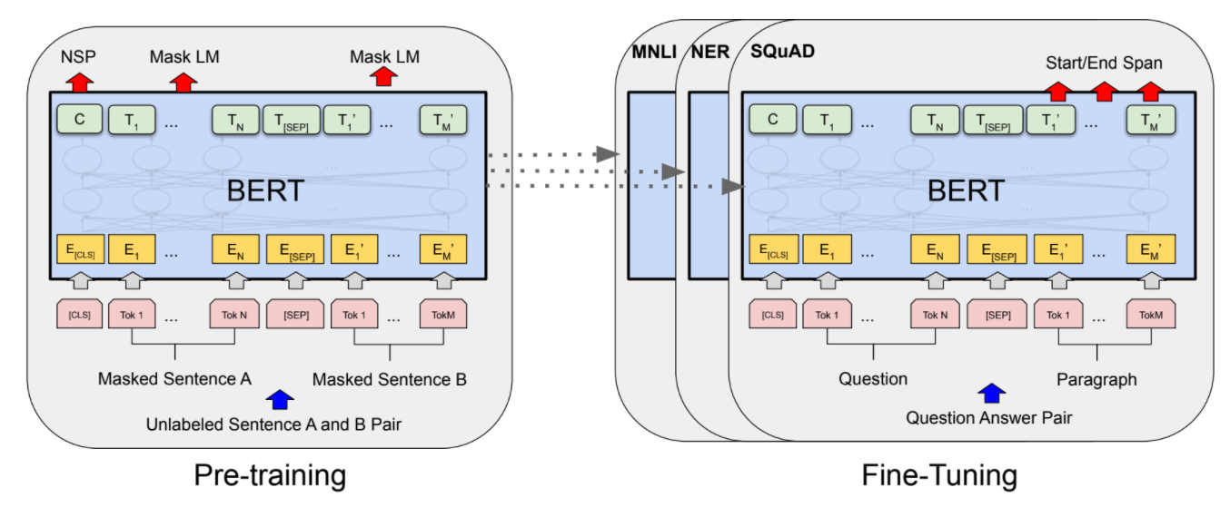
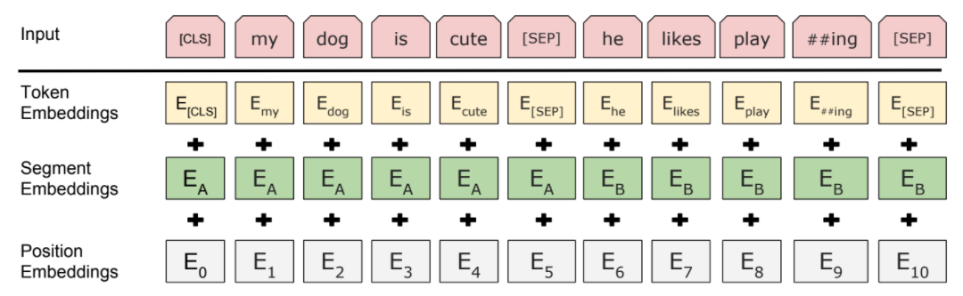
BERT
Bi-directional encoder representations from Transformers
Employs a stacked sequence of encoder and decoder layers with multiple self-attention units
Self-attention mechanisms provide non-local inputs to encoder/decoder layers
Masked (Cloze) language model (MLM) predicting tokens where some tokens are masked in random, for a given input text.

Slide 69
BERT Tutorials
Tutorial on computing word embeddings using BERT
https://colab.research.google.com/drive/16JDbd2tDn7TB8lbxcvFXTdbSYzwt0W-C?usp=sharing
Using BERT for classifying movie reviews
https://colab.research.google.com/github/google-research/bert/blob/master/predicting_movie_reviews_with_bert_on_tf_hub.ipynb

Slide 70
Lexical Processing with NLTK

Slide 71
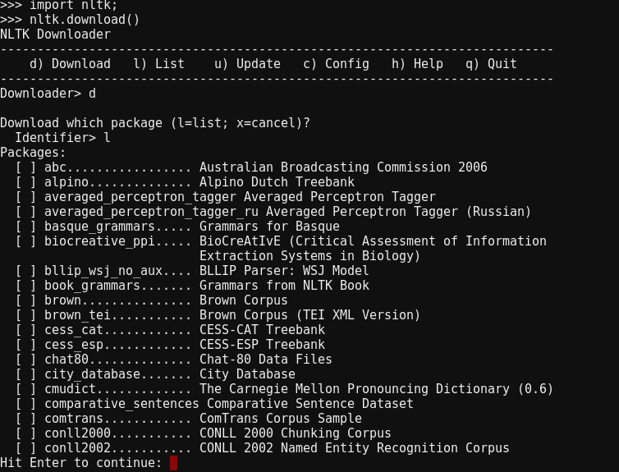
Lexical Processing with NLTK
NLTK: http://www.nltk.org/
Natural Language Toolkit for python
Provides text processing libraries for keyphrase extraction, stemming, tokenization, tagging, parsing and semantic analysis.
import nltk # import the library
Comes with over 50 corpora and lexical resources
nltk.download() # open interactive dialog to download bundled corpora

Slide 72
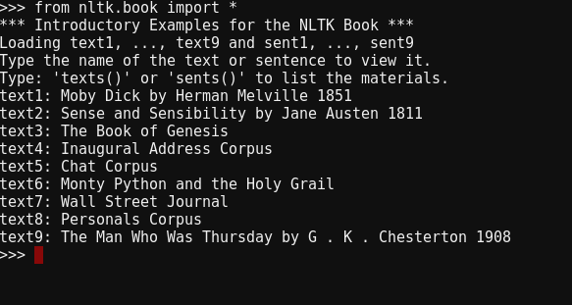
Lexical Processing with NLTK
Following examples from the “book” corpus in the NLTK corpora bundle
Every document in the corpus given a unique identifier (text1, text2, ... , text9 in the example)
Each document is an object of the class nltk.text

Slide 73
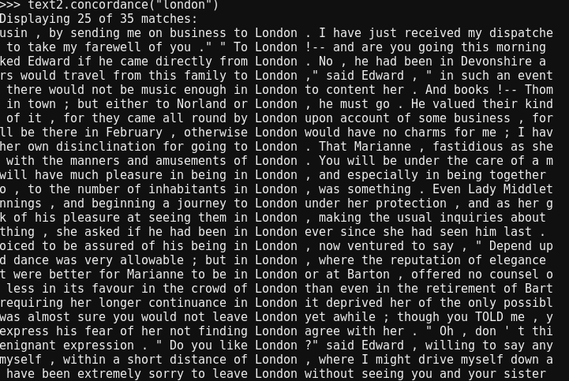
Lexical Processing with NLTK
Occurrence contexts
Occurrence contexts for a given word can be searched using the concordance() method on any nltk.text object:
text2.concordance(“London”)

Slide 74
References
LUHN, H.P., 'The automatic creation of literature abstracts', IBM Journal of Research and Development, 2, 159-165 (1958).
C. J. van Rijsbergen. Information Retrieval. Manuscript available from http://www.dcs.gla.ac.uk/Keith/Preface.html
Sahlgren, Magnus (2008). "The Distributional Hypothesis" (PDF). Rivista di Linguistica. 20 (1): 33–53.

